Slide 1
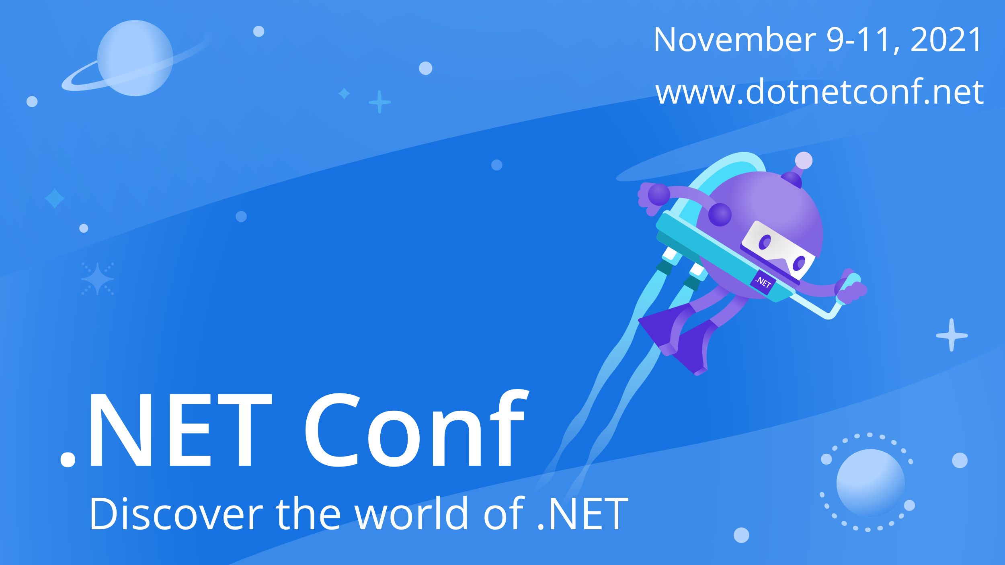

Slide 2


Blazor Azure B2C Authentication and Authorization
Michael Washington
BlazorHelpWebsite.com

Slide 3



Michael Washington
Microsoft MVP
Microsoft Certified Professional

Slide 4
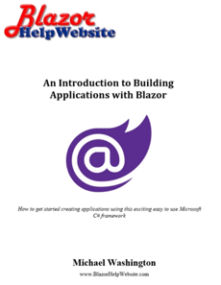


Blazor Books By Michael Washington

Slide 5
Agenda
About Azure B2C
What is Azure B2C?
Why Use Azure B2C?
Register Azure AD B2C
Register App in Azure AD B2C tenant
Configure Azure AD B2C Identity Provider & User Flow
Sample Blazor App
Using Custom Policies
The Difference between User Flows and Custom Policies
Managing Users (in Blazor Simple Survey)
Azure Set-up
Blazer App Set-Up
The Administration Page
Links
Thank You

Slide 6

About Azure B2C

Slide 7
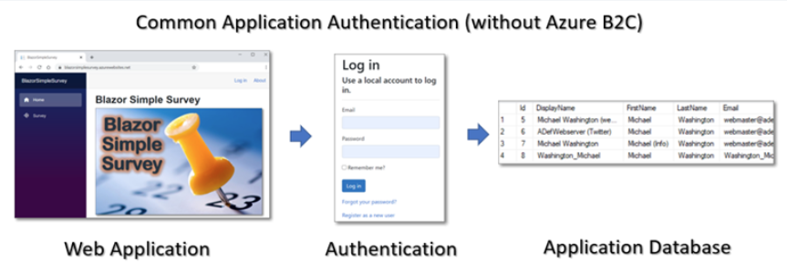
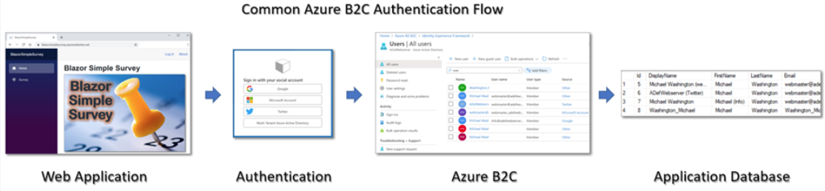

Slide 8
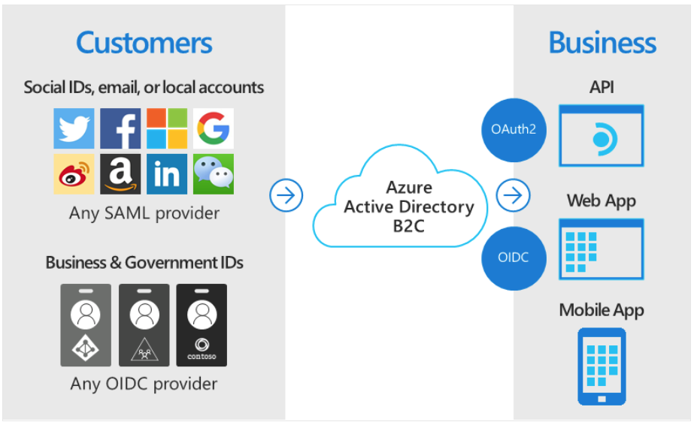
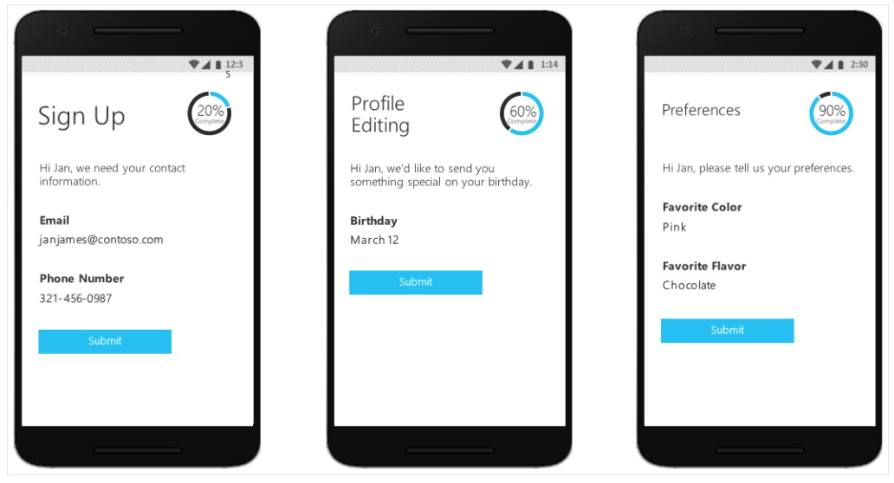
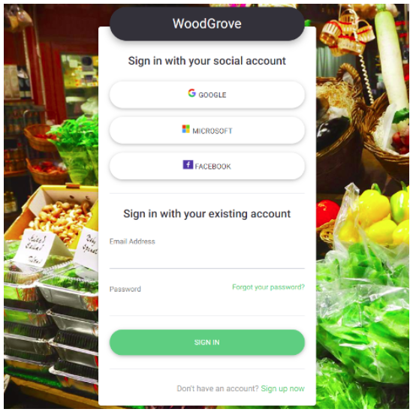
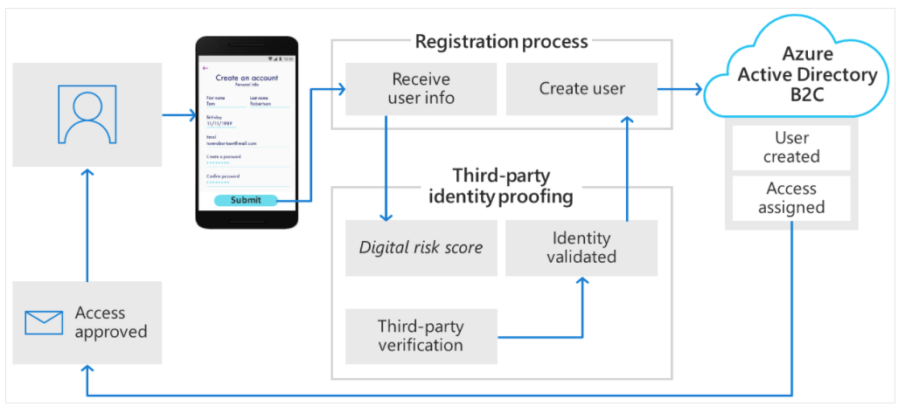
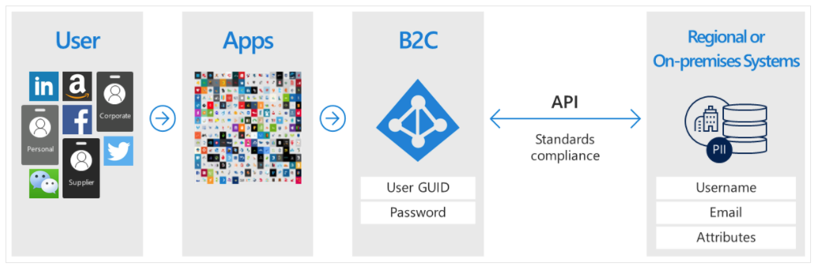
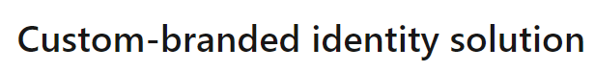
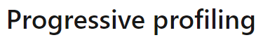
All slides © Microsoft

Slide 9
Set-Up An Azure Active Directory B2C Tenant

Slide 10
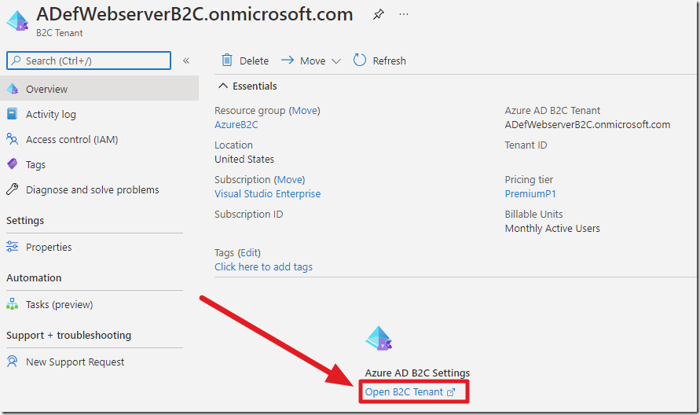
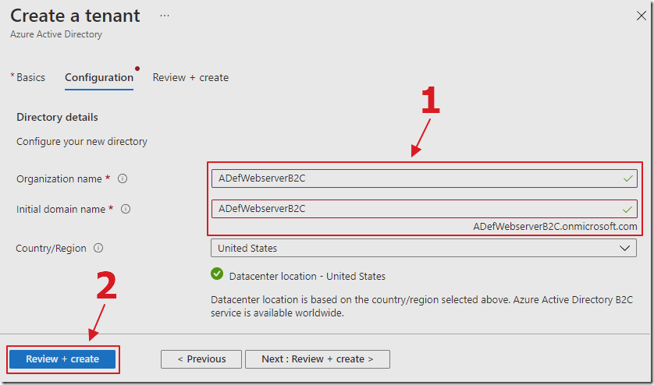
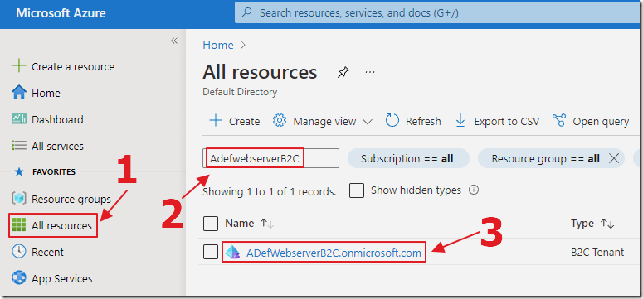
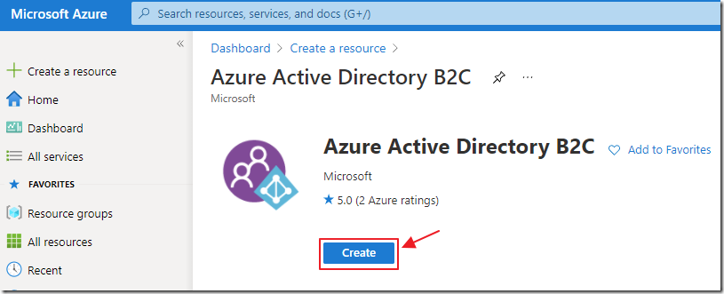
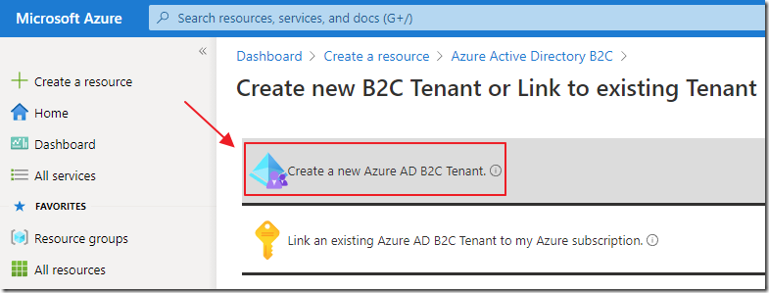
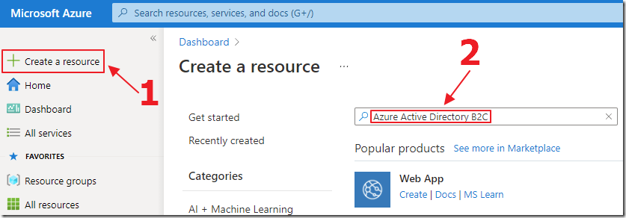

Slide 11
Register App in Azure AD B2C tenant

Slide 12
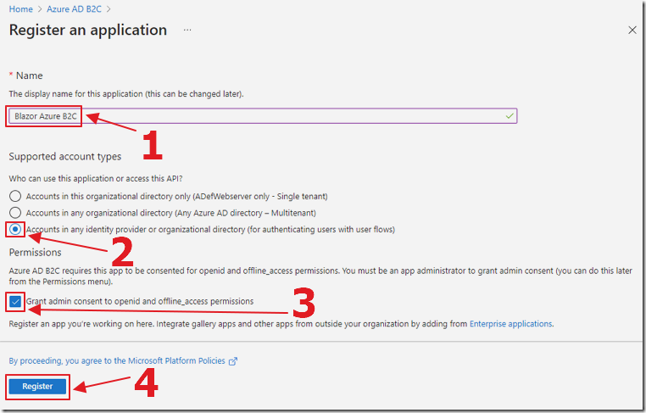
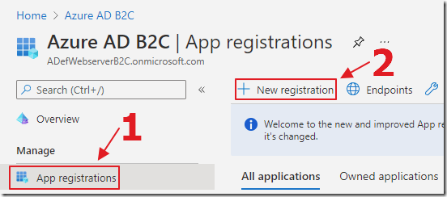

Slide 13
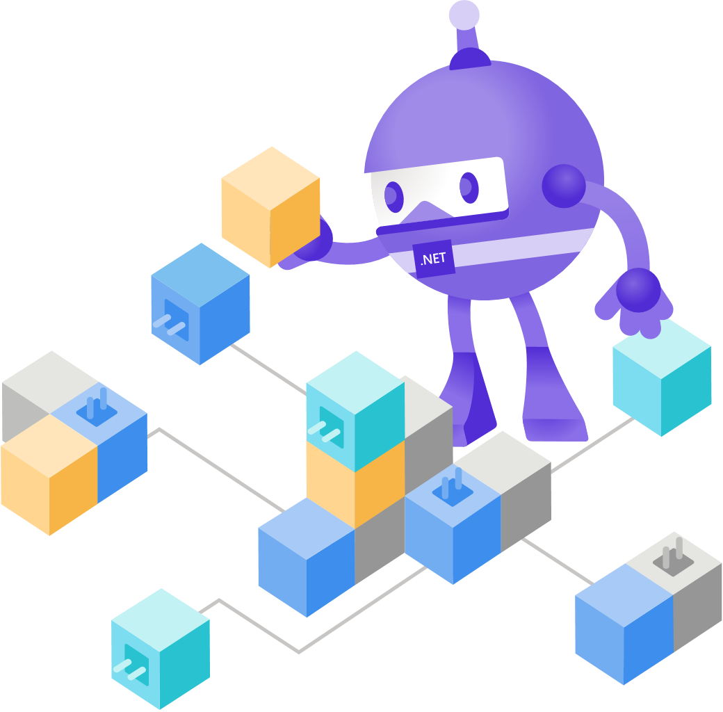
Configure Azure AD B2C Identity Provider & User Flow

Slide 14
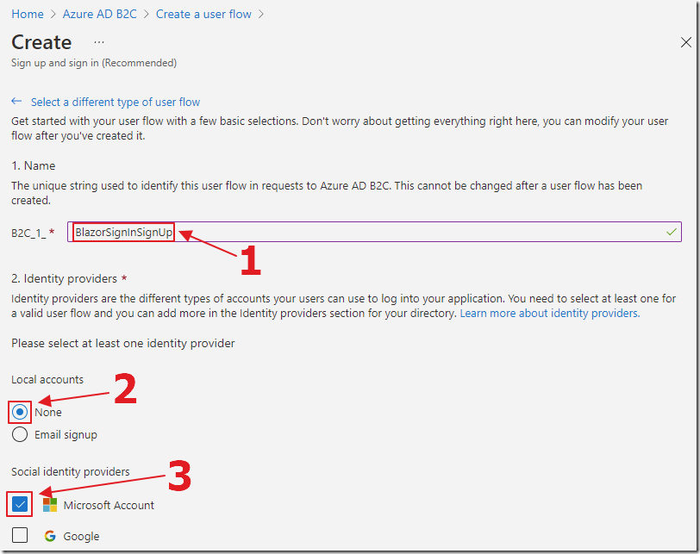
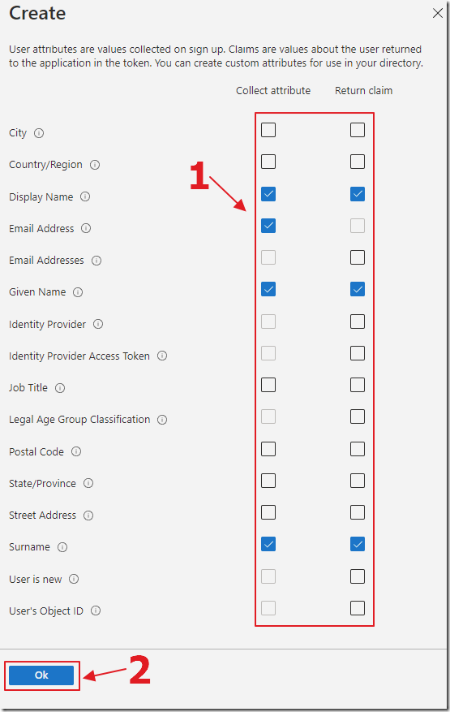
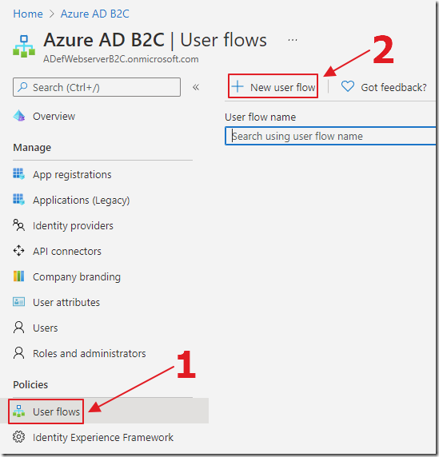
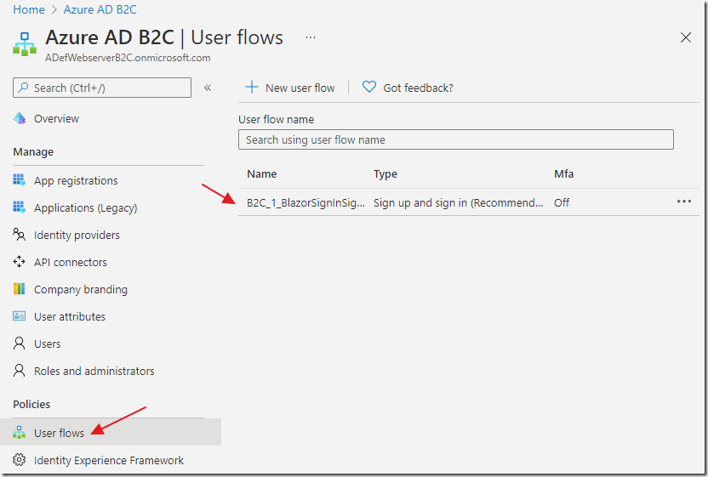
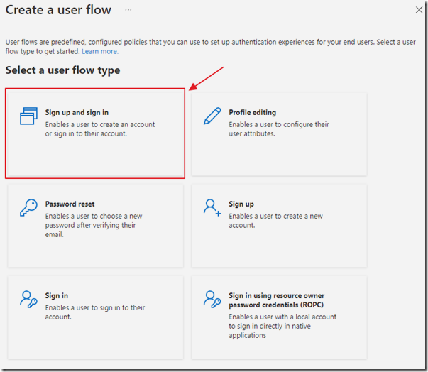
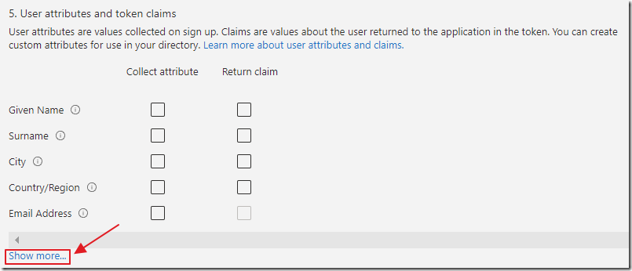
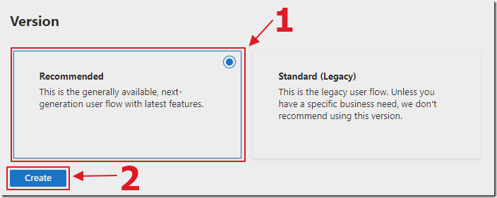
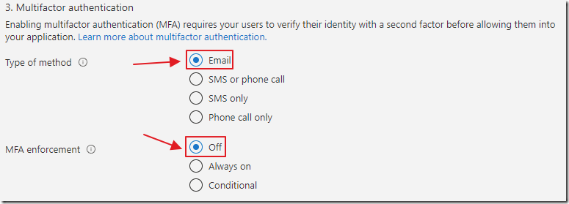
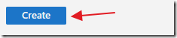

Slide 15

Sample Blazor App

Slide 16
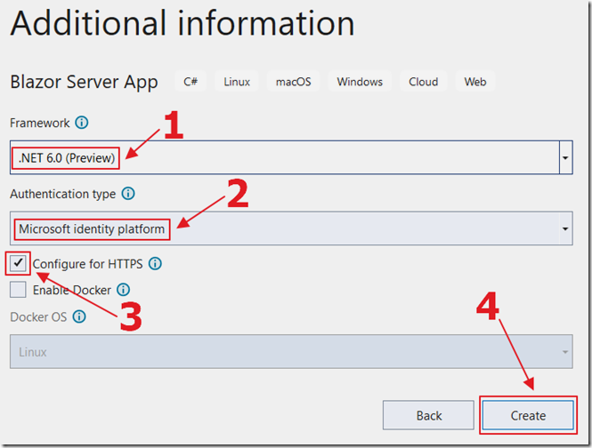
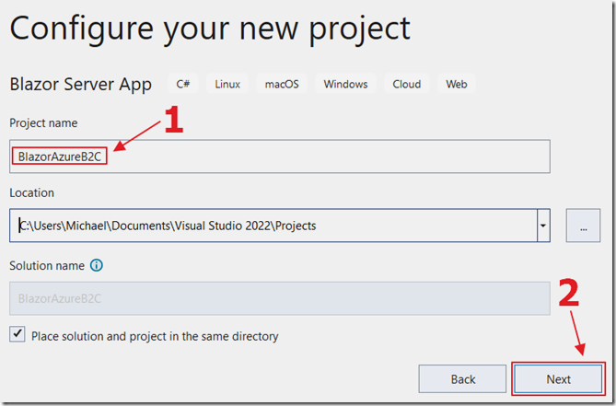
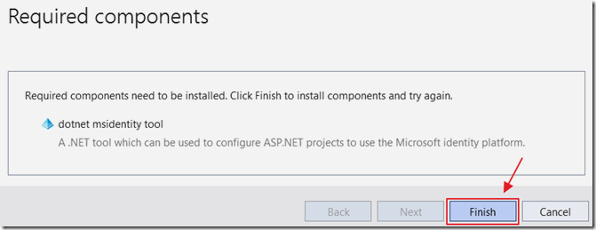

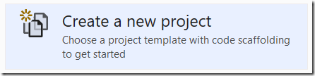
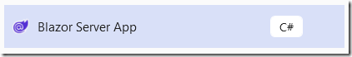

Slide 17
Demo

Slide 18
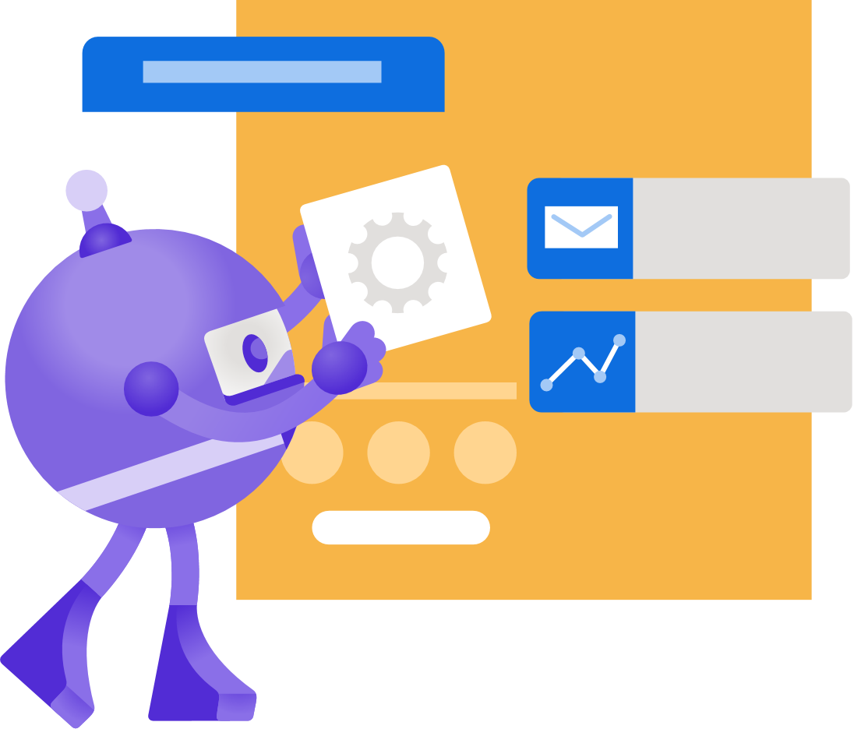
Add the Redirect URI in the Azure App Registration

Slide 19
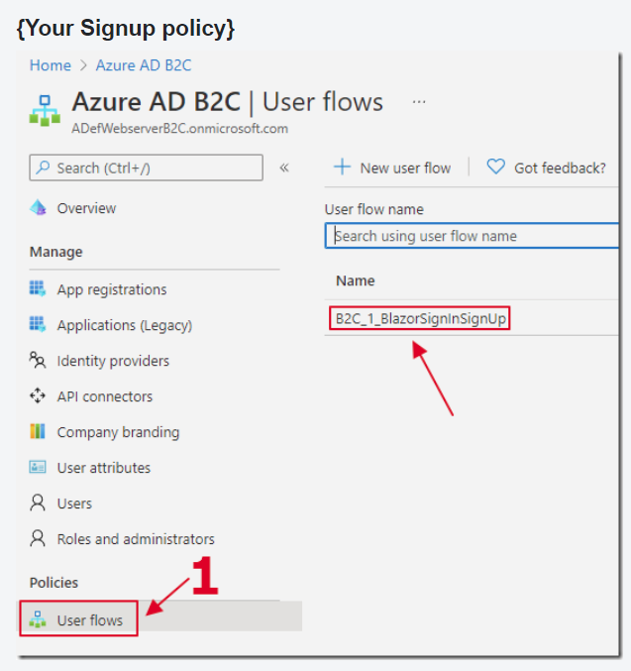
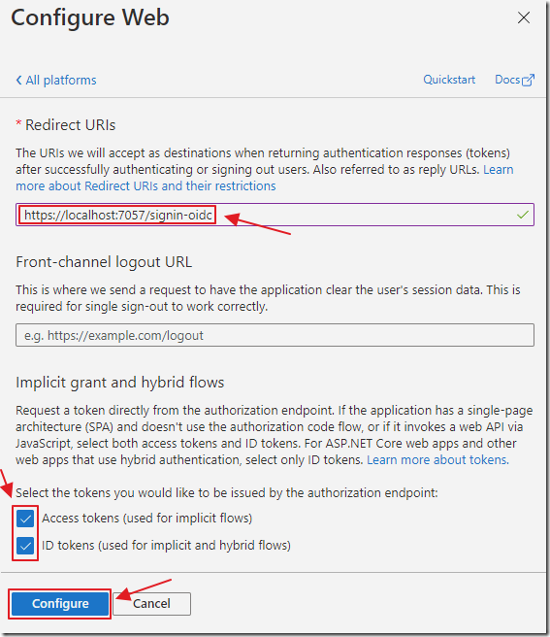
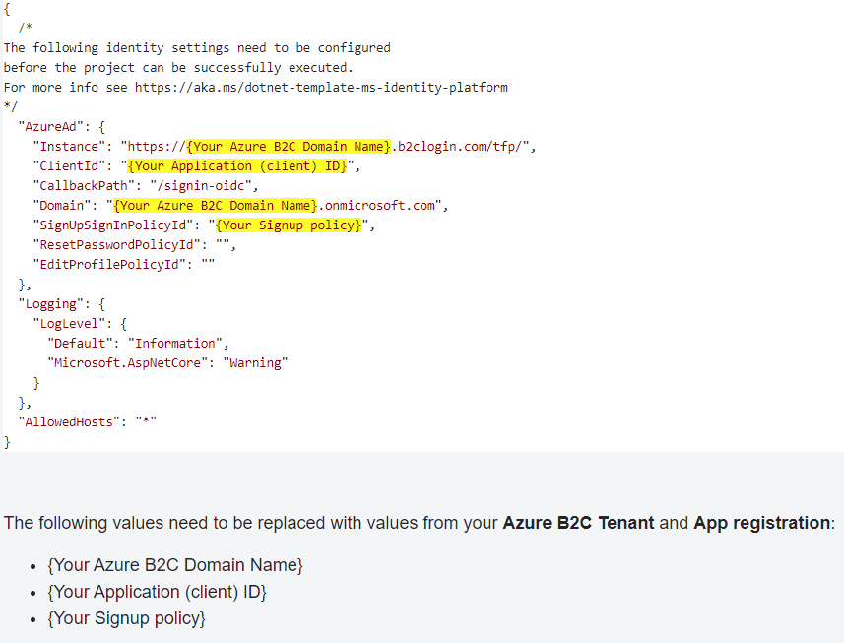
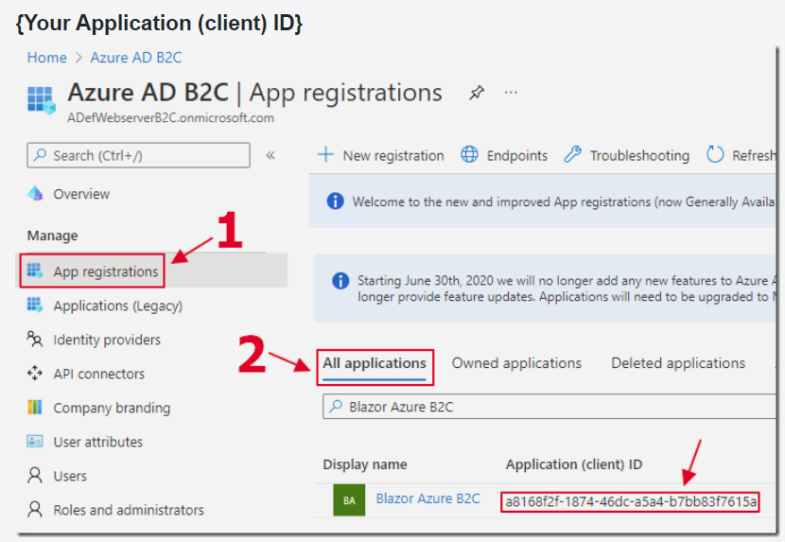
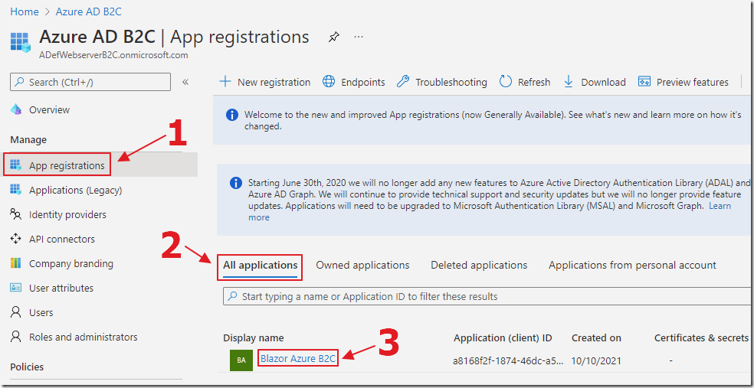
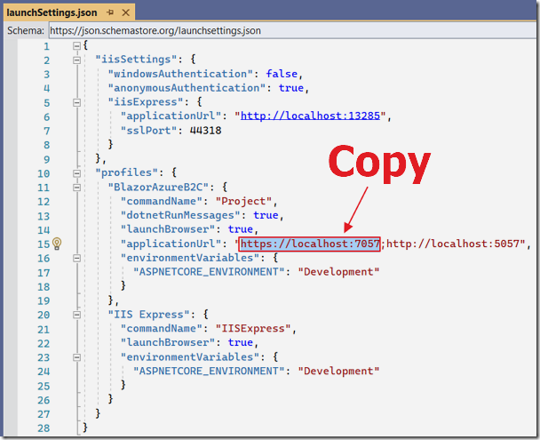
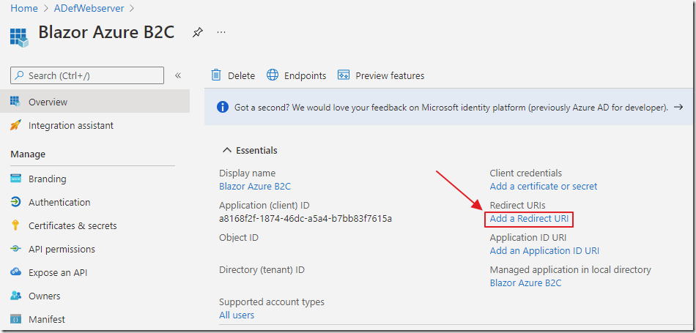
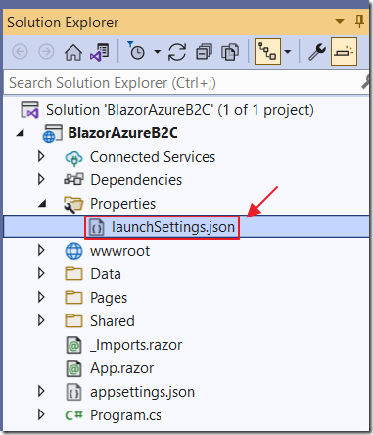
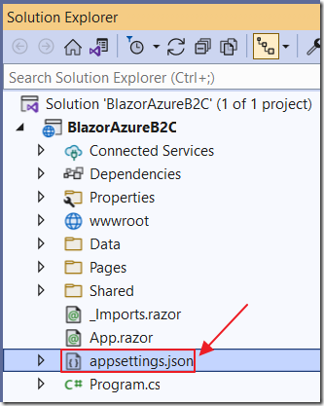
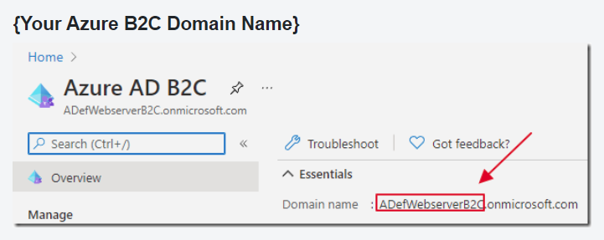
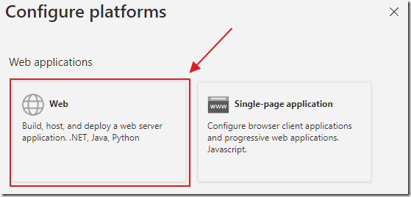
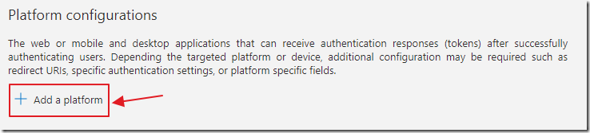

Slide 20
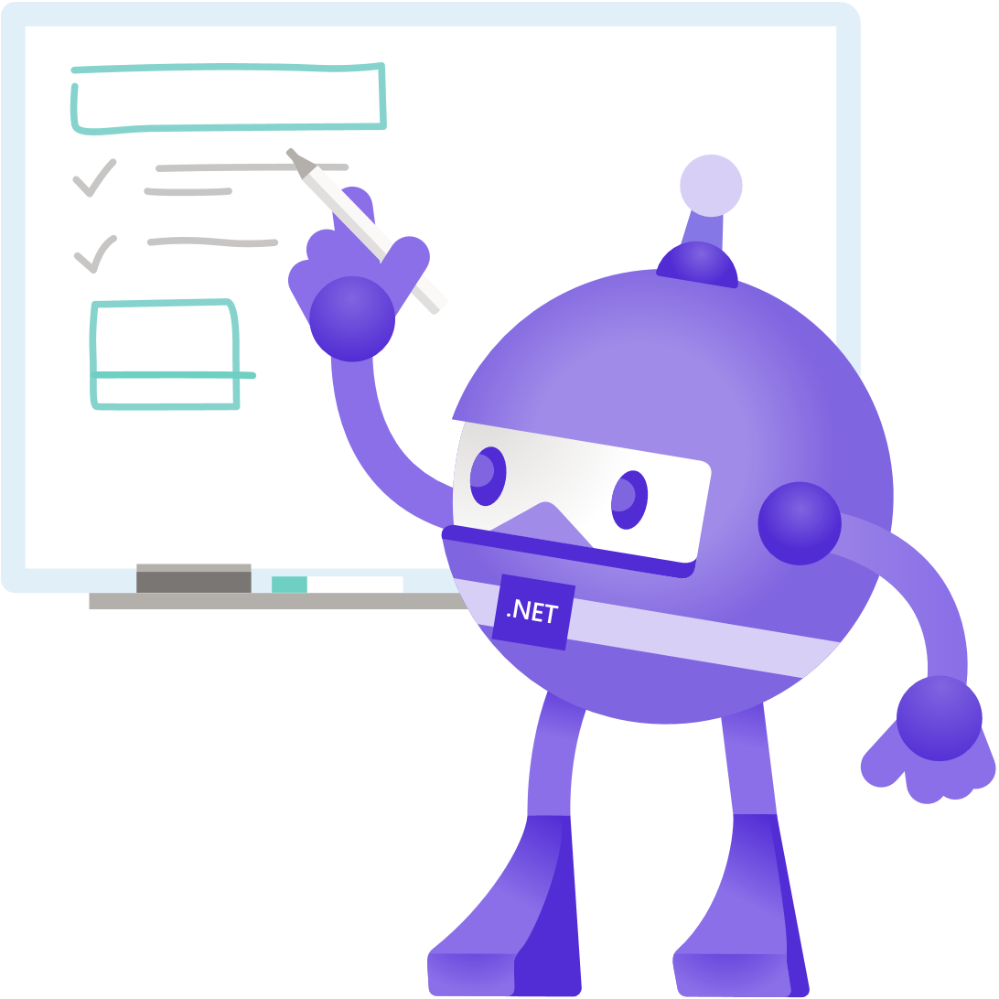
Sign-In To Azure B2C

Slide 21
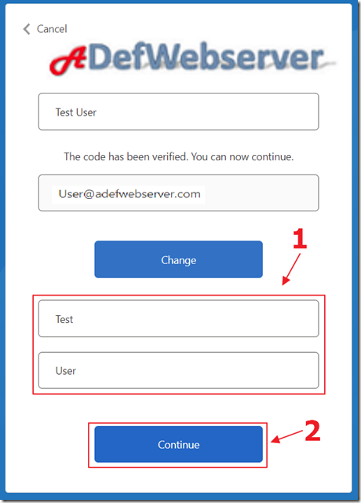
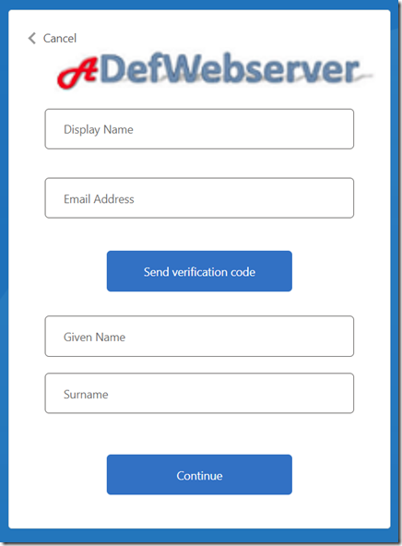







Slide 22
Demo

Slide 23

Using Custom Policies

Slide 24

The Difference between User Flows and Custom Policies

Slide 25
Context | User flows | Custom policies
Target users | All application developers with or without identity expertise. | Identity pros, systems integrators, consultants, and in-house identity teams. They are comfortable with OpenID Connect flows and understand identity providers and claims-based authentication.
Configuration method | Azure portal with a user-friendly user-interface (UI). | Directly editing XML files and then uploading to the Azure portal.
UI customization | Full UI customization including HTML, CSS and, JavaScript. Multilanguage support with Custom strings. | Same
Attribute customization | Standard and custom attributes. | Same
Token and session management | Customize tokens and sessions behavior. | Same
Identity Providers | Predefined local or social provider, such as federation with Azure Active Directory tenants. | Standards-based OIDC, OAUTH, and SAML. Authentication is also possible by using integration with REST APIs.
Identity Tasks | Sign-up or sign-in with local or many social accounts. Self-service password reset. Profile edit. Multi-Factor Authentication. Access token flows. | Complete the same tasks as user flows using custom identity providers or use custom scopes. Provision a user account in another system at the time of registration. Send a welcome email using your own email service provider. Use a user store outside Azure AD B2C. Validate user provided information with a trusted system by using an API.

Slide 26







Slide 27

Managing Users (in Blazor Simple Survey)

Slide 28




Slide 29

Set-Up The User Management Application

Slide 30








Slide 31
Detecting User Group Membership

Slide 32









Slide 33
Demo

Slide 34
The Administration Page

Slide 35






Slide 36
Demo

Slide 37
Editing A User And Their Groups

Slide 38








Slide 39
Demo

Slide 40
Editing User Groups

Slide 41






Slide 42
Demo

Slide 43


All Resources Files / Tutorials

Slide 44

Thanks for joining!

